Slide 1
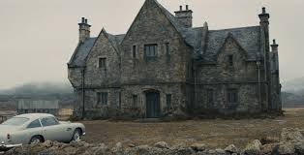
Extreme Long Shot XLS – all the character(s) are visible and small within the frame.

Slide 2
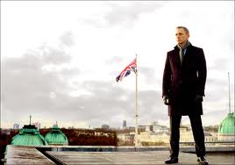
Long Shot LS – Subject’s full body fills the frame

Slide 3
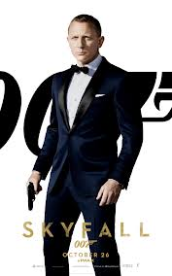
Medium Long Shot MLS or
¾ Shot – You see subject framed from the knees up.
This is a common shot in TV,
where the director wants to
prevent the audience from seeing marks on the floor.

Slide 4
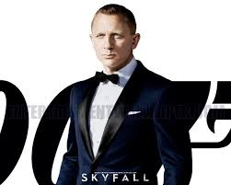
Medium Shot – MS, Subject is framed from the waist up.

Slide 5
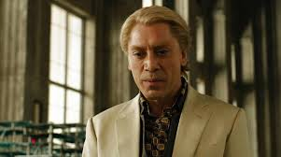
Medium Close Up MCU – Subject is framed from mid chest, around
the armpits, to the top of the head.

Slide 6
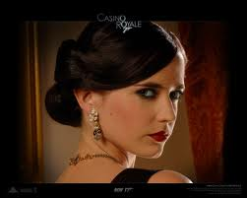
Close Up – Subject framed from top of shoulders to top of head.

Slide 7
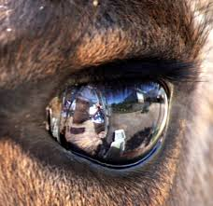
Extreme Close Up – XCU – You see a small part of a subject: an eye, a mouth, a wristwatch, etc.

